Slide 1
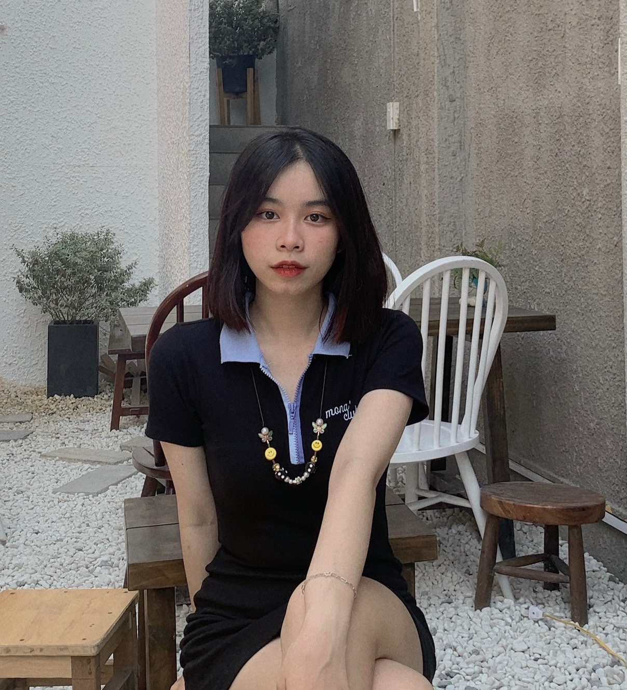
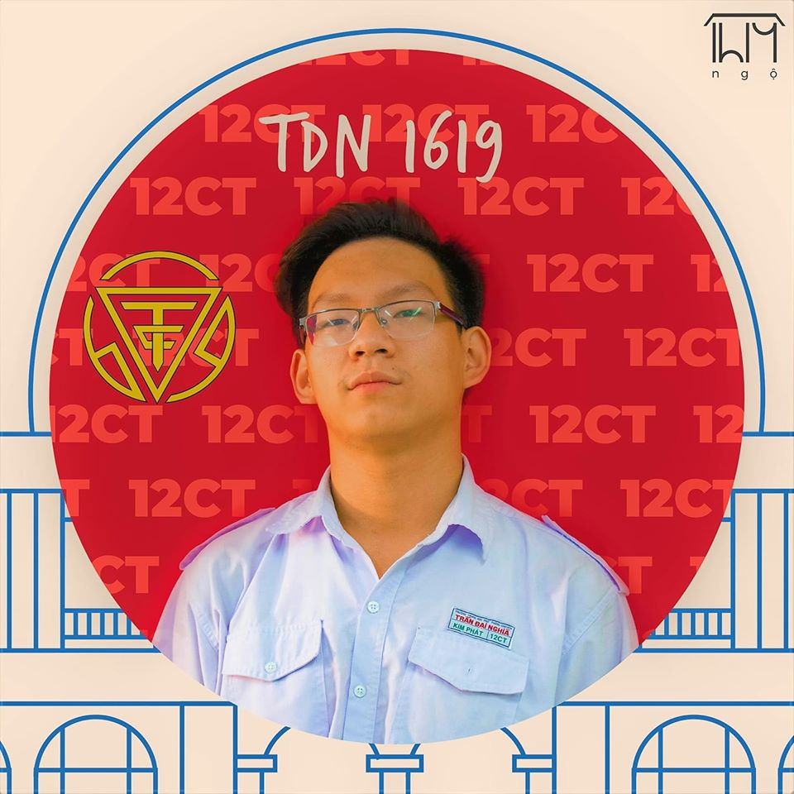
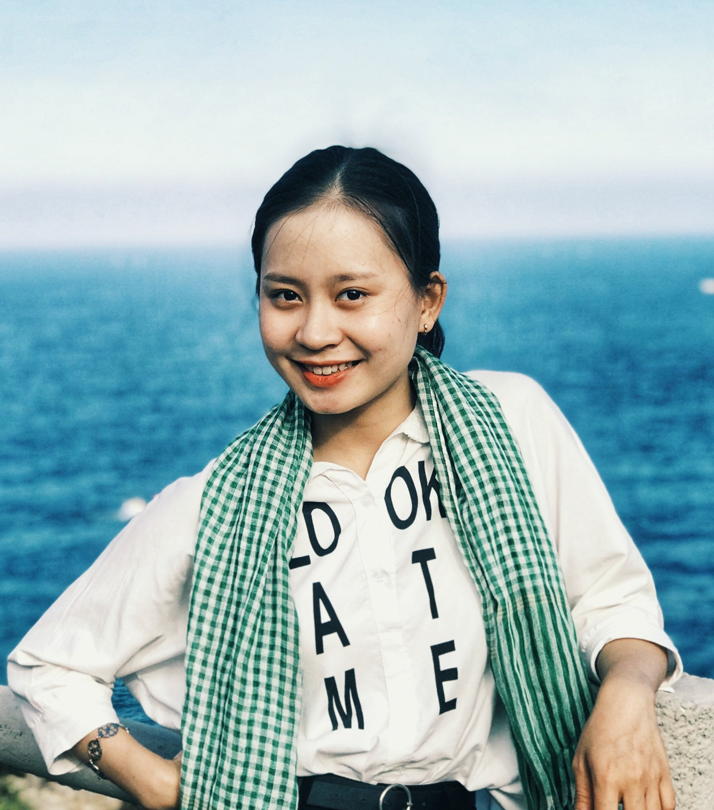
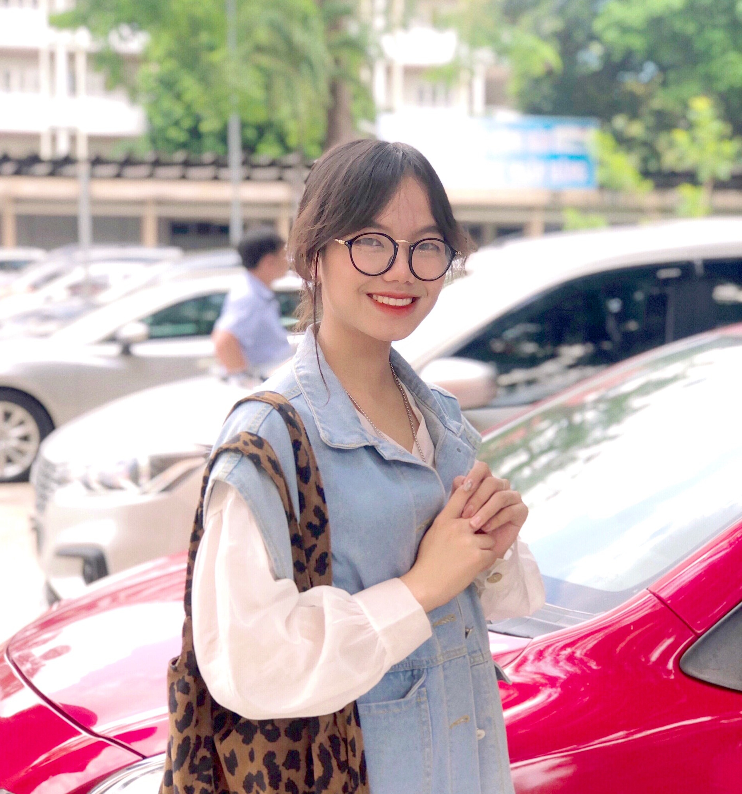
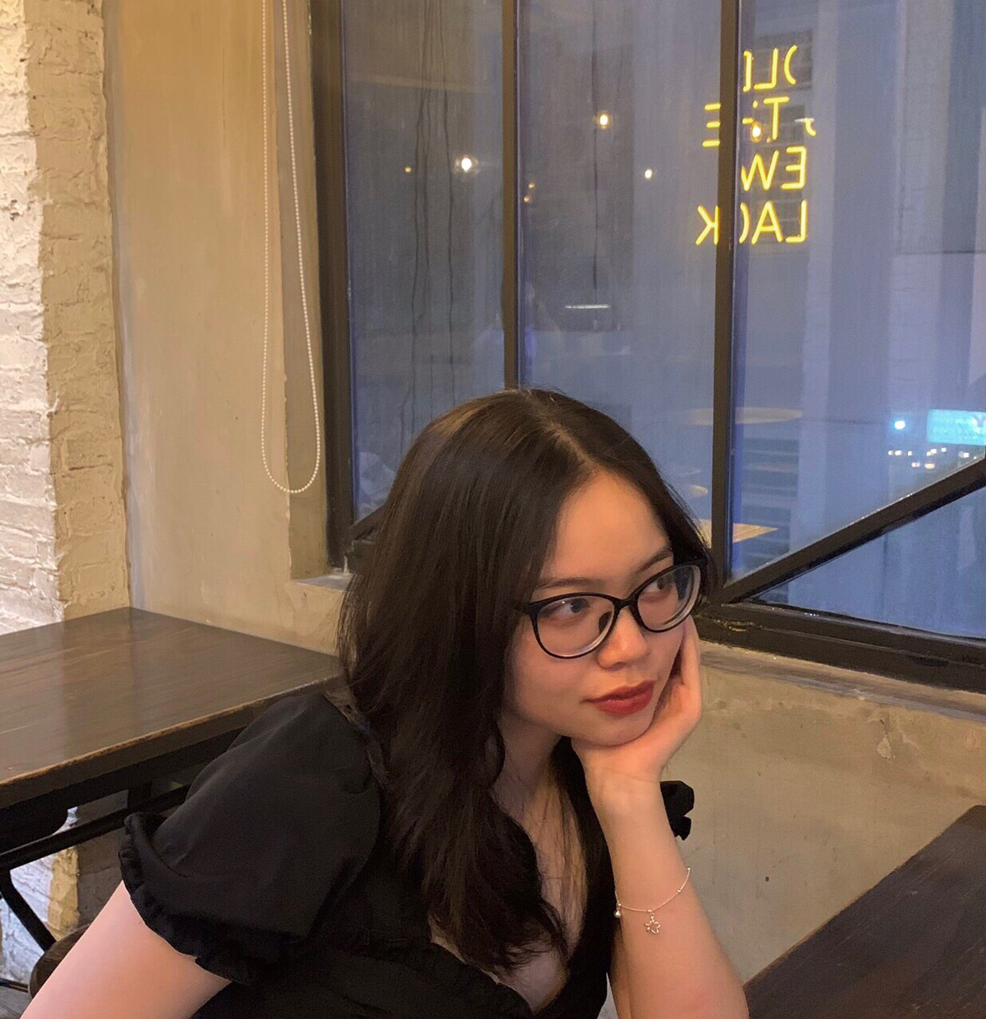
OUR TEAMS
Thuy Na
Phuong Dung
Hoang Yen
19521864
19522108
Kim Phat
Tuong Quy
19520056
19521992
LEADER
19520056

Slide 2
AUTHENTICATE
01
02
03
LOGIN
REGISTER
FORGOTPASSWORD CHECK MAIL

Slide 3
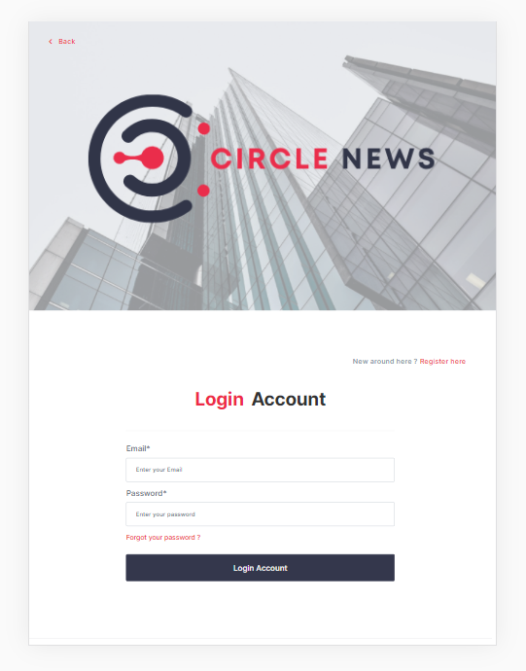
LOGIN PAGE
Validate:
All fields are required (If username/password empty
and clicked login => Notice message required)
On focus => Blur => Notice message require
Username : must be a valid email <...@....>
Password : must be higher than 6 characters
Logic:
Click Register => To Page Register
Click Forgot Password => To Page Forgot Password
Click Login Button and all validations are right => Login

Slide 4
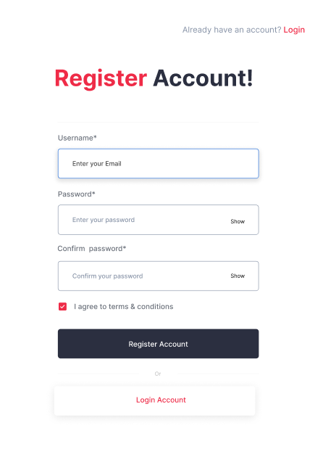
REGISTER PAGE
Validate:
All fields are required (If username/password/confirm
password empty and clicked register => Notice message
require)
On focus => Blur => Notice message require
Username : must be a valid email <...@....>
Password : must be higher than 6 characters
Confirm Password: must be the same with password field
Re-type Password Field => Empty Confirm Password Field
Logic:
Click Login => To Page Login
Click Register and all validations are right =>
Register and go to page login

Slide 5
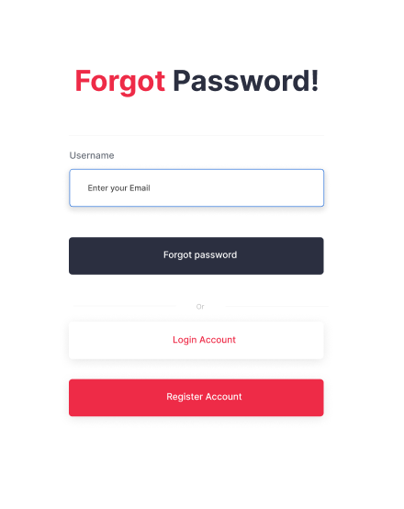

FORGOTPW & CHECK MAIL
Validate:
Field is required
On focus => Blur => Notice message require
Username : must be a valid email <...@....>
Logic:
Click Login => To Page Login
Click Register => To Page Register
Click forget password => To Page Check Your Email

